Slide 1
Impact of delays in diagnosis on healthcare costs associated with blastomycosis, coccidioidomycosis and histoplasmosis in a commercially insured population
December 16th 2024
Authors:
(CDC/NCEZID/DFWED/MDB):
Kaitlin Benedict, Michelle Fearon Scales, Mitsuru Toda, Ian Hennessee, Sam Williams
(CDC/NCEZID/DFWED/OD):
Jason Massey
f

Slide 2

Blastomycosis, histoplasmosis, and coccidioidomycosis are environmentally acquired fungal pneumonias
Blastomycosis
Histoplasmosis
Coccidioidomycosis
Notes:
Blastomycosis, histoplasmosis, and coccidioidomycosis are diseases that are caused by fungi found in the environment across the United States. People can get these diseases by breathing in fungal spores from the environment, particularly during activities that involve disturbing soil or dust. They are common causes of fungal pneumonia, but can also cause severe disseminated disease. Unlike many fungal diseases, they affect otherwise healthy people in addition to immunocompromised people.

Slide 3



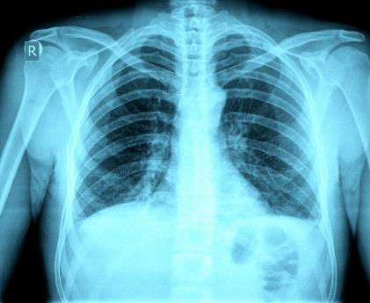



Clinical signs and symptoms are nonspecific and often resemble those of other respiratory infections
Background: Symptoms
Clinical signs and symptoms are nonspecific and often resemble those of other respiratory infections
Often mistaken for bacterial or viral community-acquired pneumonia
Fever
Cough
Fatigue
Headache
Night sweats
Muscle aches
Notes:
The clinical signs and symptoms of these diseases are nonspecific and often resemble those of other respiratory infections. These include fever, cough, fatigue, headache, night sweats, and muscle aches. Because of this they are often mistaken for bacterial or viral pneumonia.

Slide 4
Background: Unresolved illness, repeat healthcare visits
23–38 days (median time between seeking healthcare and diagnosis)
56%–70% receive another diagnosis before being tested for an endemic fungal infection
54%–60% see provider ≥3 times before tested for an endemic fungal infection
Benedict K, Ireland M, Weinberg MP, Gruninger R, Weigand J, Chen L, et al. Enhanced Surveillance for Coccidioidomycosis, 14 U.S. States, 2016. Emerging Infectious Diseases. 2018 Aug; 24(8).
Alpern JD, Bahr NC, Vazquez-Benitez G, Boulware DR, Sellman JS, Sarosi GA. Diagnostic Delay and Antibiotic Overuse in Acute Pulmonary Blastomycosis. Open Forum Infect Dis. 2016 Apr 19;3(2):ofw078.
Benedict K, McCracken S, Signs K, Ireland M, Amburgey V, et al. Enhanced Surveillance for Histoplasmosis–9 States, 2018–2019 . Open Forum Infect Dis. 2020 Sept; 7(9):ofaa343.
Notes:
Patients with these diseases often experience long delays before getting a proper diagnosis and treatment: the median time between first healthcare and getting a diagnosis is close to a month, 56-70% received another diagnosis before being tested, and more than half see a provider at least three times before being tested.

Slide 5
Background: Overuse of unnecessary antibiotics
>50% receive antibiotics before diagnosis of histoplasmosis or coccidioidomycosis
Most patients receive ≥2 rounds of antibiotics before being tested for an endemic fungal infection
Benedict K, Ireland M, Weinberg MP, Gruninger R, Weigand J, Chen L, et al. Enhanced Surveillance for Coccidioidomycosis, 14 U.S. States, 2016. Emerging Infectious Diseases. 2018 Aug; 24(8).
Alpern JD, Bahr NC, Vazquez-Benitez G, Boulware DR, Sellman JS, Sarosi GA. Diagnostic Delay and Antibiotic Overuse in Acute Pulmonary Blastomycosis. Open Forum Infect Dis. 2016 Apr 19;3(2):ofw078.
Benedict K, McCracken S, Signs K, Ireland M, Amburgey V, et al. Enhanced Surveillance for Histoplasmosis–9 States, 2018–2019 . Open Forum Infect Dis. 2020 Sept; 7(9):ofaa343.
Notes:
These long delays contribute to the overuse of unnecessary antibiotics, with greater than 50% of patients receiving antibiotics before receiving a fungal diagnosis. Most receive multiple round of antibiotics as well. Diagnostic and treatment delays also can lead to a greater risk for hospitalization and severe outcomes.

Slide 6
Background: Increased healthcare costs
A previous study reported that diagnostic delays in coccidioidomycosis were associated with >$500,000 increase in healthcare costs at a single center (n = 276 patients) in Tucson, Arizona.¹
However, this association has not been examined for coccidioidomycosis in other areas or for blastomycosis or histoplasmosis.
Large-scale data are needed to guide public health action and policy.
1. Donovan et al 2019. EID. https://pmc.ncbi.nlm.nih.gov/articles/PMC6711243/
Notes:
Diagnostic delays like contribute to increased healthcare costs; for example, a previous study at a hospital in Tucson, Arizona found that diagnostic delays for patients with coccidioidomycosis were associated with >$500,000 in excess healthcare costs over the course of two years.
However, similar data are lacking for coccidioidomycosis in other areas of the country as well as for blastomycosis and histoplasmosis. Large-scale data could help guide public health action and policy.

Slide 7
Project Objective and Hypothesis
Project objective: Our goal is to model the impact of diagnostic delays on cost of treatment for endemic mycoses (coccidioidomycosis, blastomycosis, histoplasmosis).
We hypothesize that diagnostic delays will significantly increase the cost of treatment.
We are using a large commercial health insurance claims database to evaluate this question.

Slide 8
Causal Diagram
Effect we are trying to estimate
Delay to diagnosis (days)
Cost of healthcare visits and treatment
Potential confounders
Confounders: Sex, age group, urbanicity, insurance status, antibiotics, antifungals, previous immune condition

Slide 9
Methods – Data
Used MarketScan health insurance claims data to identify patients diagnosed with histoplasmosis, coccidioidomycosis, blastomycosis (based on ICD-10 codes) during 2017-2022
Patients needed to be continuously enrolled in the 90 days before and 365 days after their diagnosis (index date)
Identify compatible symptoms or respiratory illnesses that could be mistaken for fungal disease
Delay time: the number of days between the first visit for compatible symptoms and the index date
Total costs (2024 USD) associated with disease: outpatient visits, hospitalizations, antibiotics, and antifungals
Adjust for demographics: sex, age, region, insurance type, urbanicity, and presence of underlying condition(s)

Slide 10
Methods – 2 issues
The association between delay in diagnosis and cost may be confounded by certain characteristics (e.g., patient age, underlying medical conditions, etc.). To address this, we needed to use probability weights.
The distribution of our exposure was heteroscedastic and zero-inflated, and the full outcome model was non-linear. This influenced both the type of weights and the type of outcome models we used.
Notes:
The association between delay in diagnosis and cost may be confounded by certain characteristics (e.g., patient age, underlying medical conditions, etc.). To address this challenge, we created weights which equalize the sample size and composition of patients across the zero-to-90-day delay-to-diagnosis time.
Our distribution of our exposure was heteroscedastic and zero-inflated. Meaning there were so many more patients who experience no delay in diagnosis (or were immediately diagnosed). Also, the relationship between delay time and cost saw a huge jump from those with no delay to those with any delay at all; however, remained somewhat linear among those patients with a delay. This influence both the type of weights we used prior to modeling and the type of outcome models we used as well.

Slide 11
Methods – Resolving Causality Issue
First, we used quantile binning to assign an equal number of observations to each of the five categories with delay times greater than zero. Zero delay time between the first visit for compatible symptoms and the index date received its own category.
Second, we used overlapping probability weighting to balance out the populations within each delay-to-diagnosis time bin. This method ensures analysis of the effect of delayed diagnosis on costs, rather than impacts from confounding patient characteristics.
Solving Simpson’s Paradox with Inverse Probability Weighting | by Ehud Karavani | Towards Data Science
Notes:
The issue is that there may be a causal link between the cost and the delay in diagnosis time for an individual based on their other potentially confounding characteristics (e.g. age, immunocompromised, etc), so people that have 15 day delay in diagnosis may have quite different characteristics than the people that have 60 or 90 day delay in diagnosis. Because of this, the populations that we are comparing across these different delay times may not be consistent and therefore we can't tell whether the differences in costs are actually due to the delay in diagnosis or due to these other confounding characteristics being over/underrepresented in certain groups. For example, immunocompromised patients may have shorter delay times to diagnosis because they are more frequently getting healthcare (but may also have higher costs associated with that), so those patients may be overrepresented in the earlier delay time bins than in the later delay time bins and that could bias the results.
Therefore, this is why we use the inverse probability weighting, which is essentially a way to balance out the populations within each of our delay to diagnosis time bins so that we are comparing relatively equivalent populations based on these confounding characteristics to analyze across. This way we can be more certain that we are actually analyzing the effect of delayed diagnosis on costs rather than impacts from other confounding patient characteristics that also happen to correlate with the delay time.

Slide 12
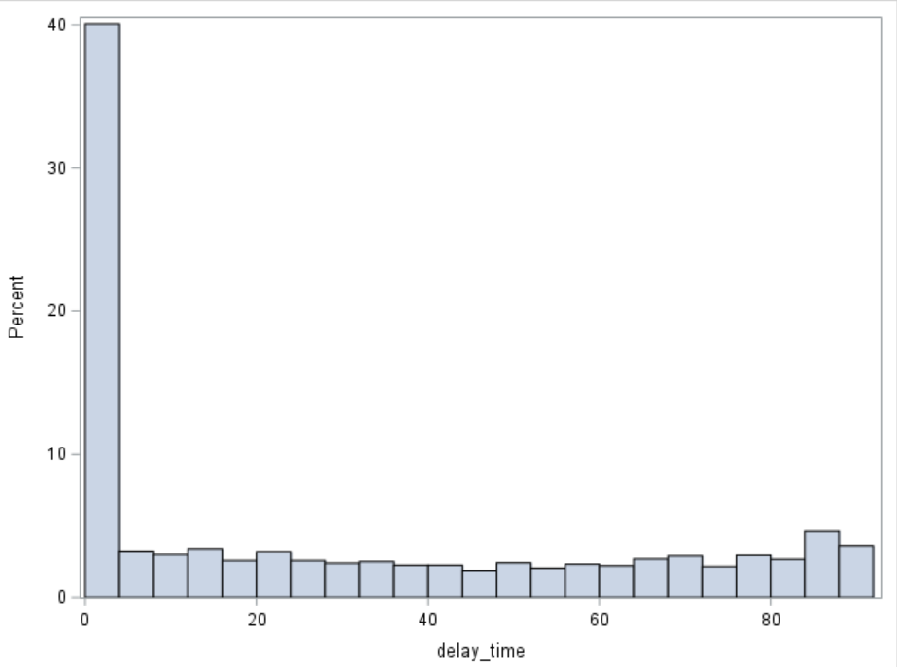
Exposure Issue (Weights)
Distribution of zero inflated exposure delay time
0 Delay time: N=1,654 (37.8%)
>0 Delay time: N=2,727 (62.2%)
Notes:
The distributions for delay time. This provides motivation referring to the literature to use specifically quantile binning probability weights for zero-inflated heteroscedastic exposures. naimi_constructing_ipw_for_continuous_exposures_epidemiology_2014.pdf

Slide 13
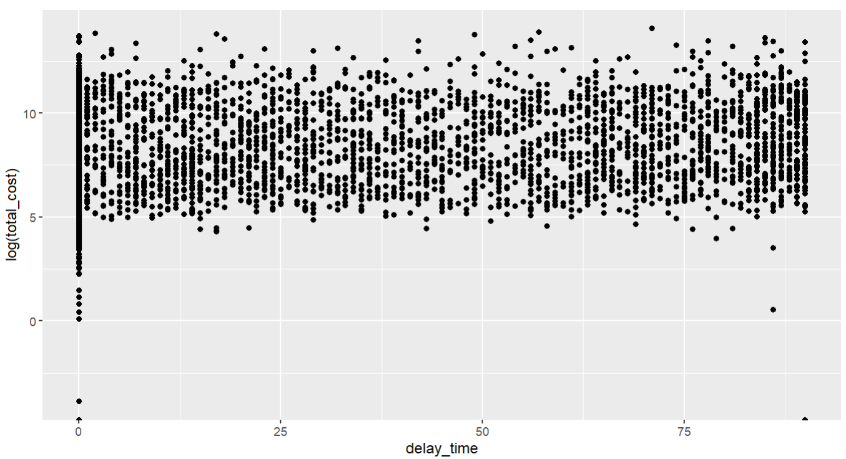
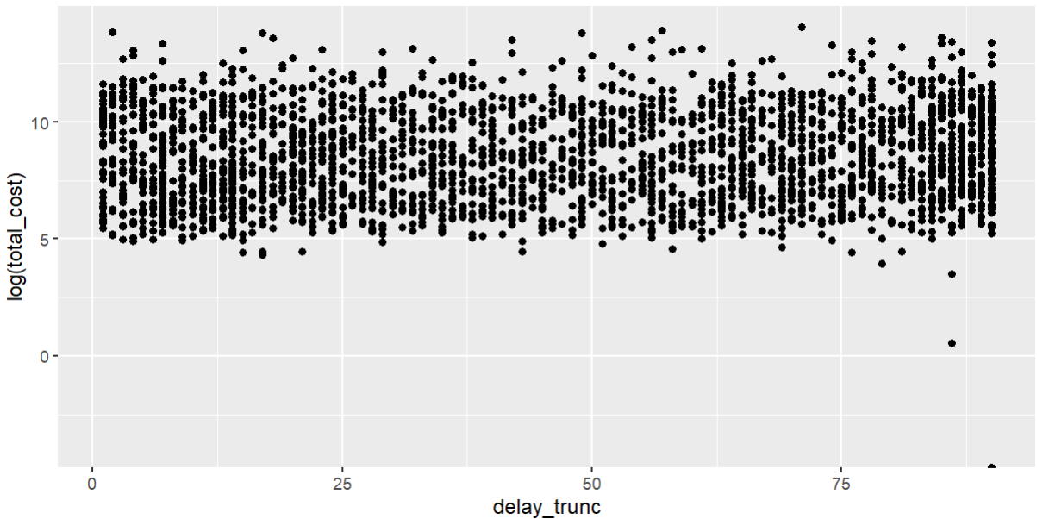
Exposure Issue (Outcome Models)
Non-truncated:
Scatterplots of the distribution of delay time by log(cost). The zero inflated exposure skewed the association when running linear regression
Truncated:
Notes:
Our exposure also creates an issue after applying weights when trying to find the right model fit. It is non-linear when including zero (no delay in diagnosis); however, is relatively linear if we exclude it. We wanted to capture both the difference between no delay and those with various periods of delay. We also wanted to capture the linear increase in cost when excluding zero. This led ultimately to the two models we used.

Slide 14
Methods – 2 Outcome Models
Truncated Linear Model – Excluding those with no delay time, this model uses a subset of our dataset to show the change of USD per day of delay.
Categorical Regression Model – Including the full analytic dataset, this model shows the mean extra costs accrued when comparing patients who experienced a delayed diagnosis within 3 subsequent 30-day time period categories to those who experienced no delay as our reference category.
Notes:
Other models/methods tried: We looked at a GAM, full linear model (which drastically overestimated the relationship compared to the truncated), binary model, and quartile model. The zero+ 3 category model in addition to the truncated linear model gave the best results

Slide 15
Results (Truncated Linear Model)
$131.00 ($54.67—$207.33) increase of cost per day of delay time for blastomycosis, coccidioidomycosis, and histoplasmosis combined (p<0.001).
$174.86 ($35.68—$314.05) increase of cost per day of delay time for coccidioidomycosis (p=0.01).
$38.00 (-$147.83—$223.83) increase of per day of delay time for histoplasmosis (p=0.69).
Notes:
Blasto alone had non-significant results.

Slide 16
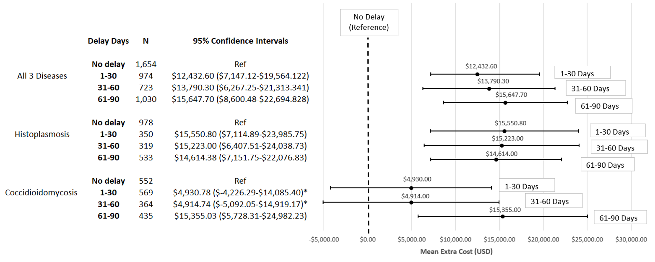
Results (Categorical Model)
Notes:
This shows the mean extra cost accrued by those with a delay in diagnosis of 1-30 days, 31-60 days, and 61-90 days each when compared to those who experienced no delay in diagnosis. First in all three diseases combined, then histo and cocci alone. Blasto had non-significant results.

Slide 17
Conclusions
Healthcare costs for patients with blastomycosis, coccidioidomycosis and histoplasmosis and diagnostic delays were significantly higher than those without delays, similar to a previous study of patients with coccidioidomycosis from Tuscon, AZ.
There were greater costs for patients with any delay that were diagnosed with histoplasmosis alone or greater than 60 days delay for those diagnosed with coccidioidomycosis.
Costs increased with each day of delay, for coccidioidomycosis alone as well as for blastomycosis, coccidioidomycosis and histoplasmosis combined

Slide 18
Limitations
Potential disease misclassification inherent in medical coding data.
Patients who were never diagnosed or never sought care were not included.
Our cost estimates only represent direct medical costs; indirect costs accounting for productivity loss are likely to be substantially higher.

Slide 19
Potential Impacts
Encourage greater prioritization of early testing for fungal pathogens by demonstrating the costs of delays in time to diagnosis.
Aim to reduce patient healthcare costs by improving early diagnosis and appropriate treatment, which also promotes antimicrobial stewardship by reducing inappropriate antibiotic use.
Enhancing awareness in the medical and public health community about fungal community acquired pneumonia.
In the future, our models may allow us to understand how different interventions that reduce diagnostic delays could reduce treatment costs.

Slide 20
Next Steps
Target journal and audience: Planning to submit to Clinical Infectious Diseases. Aiming to reach a clinical, hospital administrator, and public health audiences.
Next steps: Planning to conduct additional evaluations looking at proportion of costs from outpatient visit, hospitalization, and medication, and by disease type (pulmonary, disseminated, etc.).
Hope that this information will provide greater context for the burden of costs and interpeting out results.

Slide 21
Discussion Questions
Are there any other measures or information that we can provide from this analysis to further convince partners of the importance of early diagnosis?
What other messaging do you think would be impactful to include in this paper and its promotion?
How can we promote resources to help justify the need for earlier consideration of fungal etiology and help providers test for fungal infections to distinguish from other forms of CAP?
How can we use these findings to leverage policy changes? What scale of policy changes would be most impactful (e.g., health systems or insurance providers)?
What systems-level changes can be made to help facilitate testing (e.g., prompts within EMR systems)?

Slide 22
Supplemental Slides

Slide 23
Methods - Weighting
1. Create N = 6 bins make sure zero is its own bin. Non-zero bins are broken into quintiles
2. Fit a multinomial logistic regression model to these categories to obtain the predicted probabilities of falling into the observed exposure category (this creates our PS variables)
3. Use inverse probability weighting/other weighting (overlap, etc.) to transform PS into a weight variable
4. Check balance of different weights
5. Now run regression models with weights
Notes:
The literature says too few bins and there won’t be sufficient balance in the covariates after weighting; however, the more bins created increases the chances that the sample sizes will be too small and lose power. Our assessment led us to use 6 bins (zero as its own bin and non-zero quintiles for the other 5 bins)

Slide 24
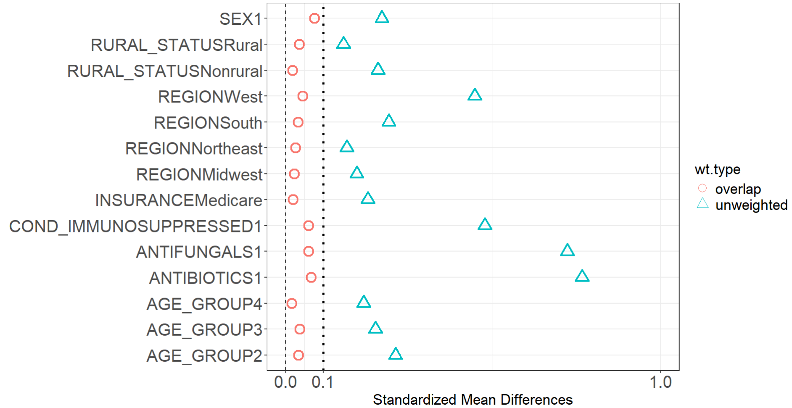
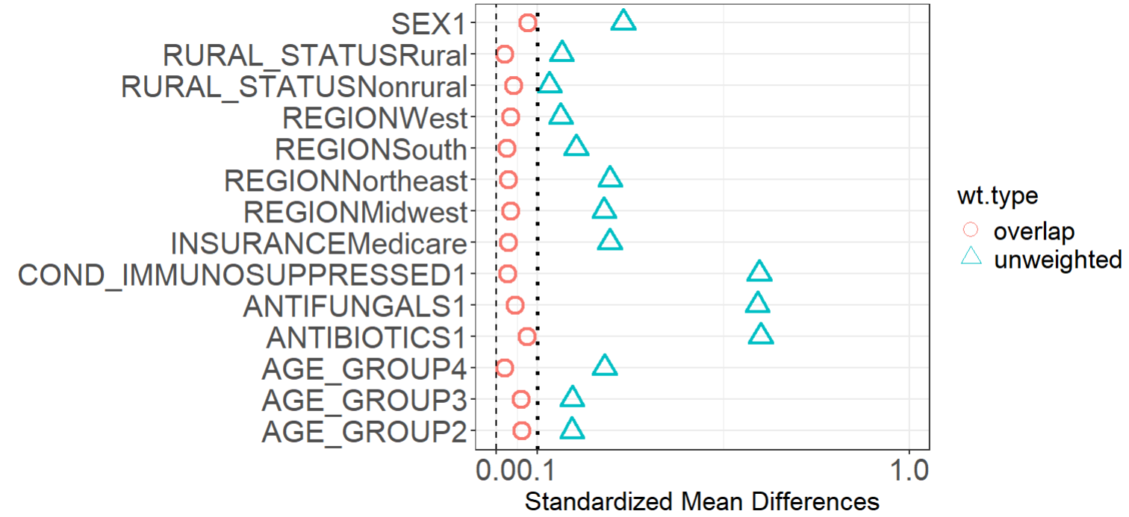
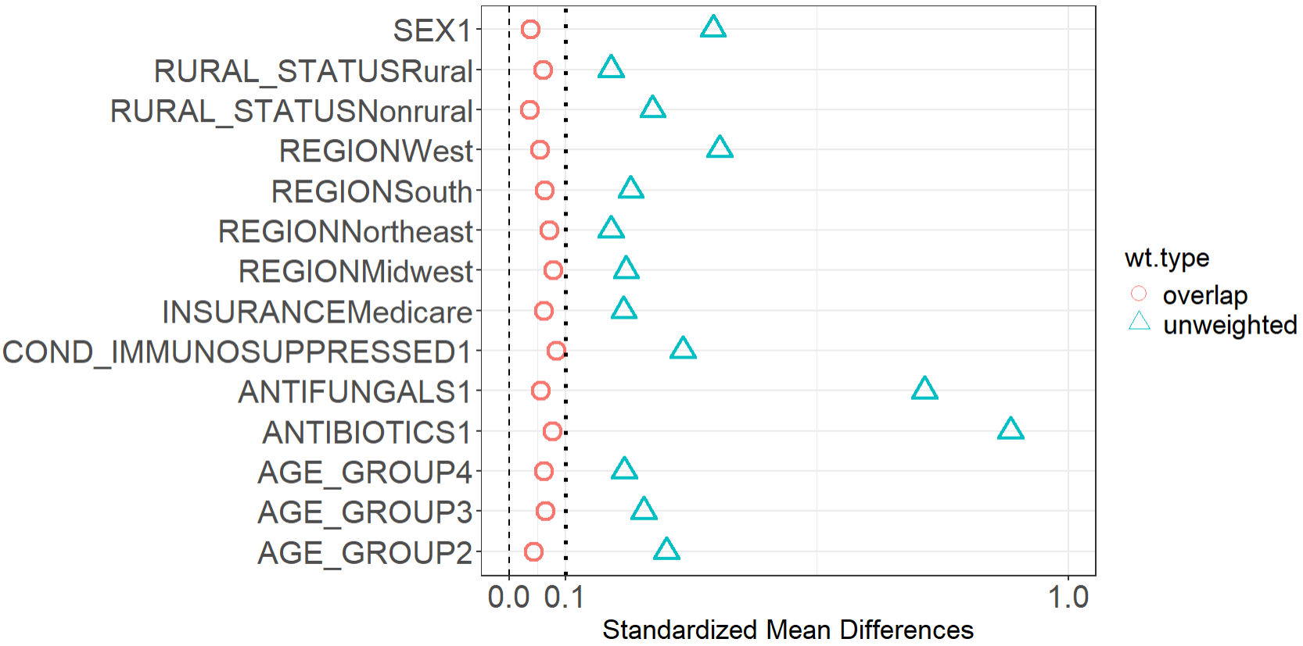
Weight Balance
All 3 Diseases Coccidioidomycosis Histoplasmosis

Slide 25
Weight Balance
Cocci
Histo
All 3

